Slide 1


Innovation Flows Here.

Slide 2
University Database System: Design and Implementation
Andre de Breyne
Andre Ricardo Caralli Junior
Bruno de Arantes Leite Sassi
Isaac Inalegwu Agba
2025/03/25

Slide 3
Project Objective
Develop a database to manage university academic operations.
Support student enrollments, grades, courses, semesters, and prerequisites.
Generate datasets for machine learning (e.g., predicting student performance)

Slide 4
System Overview
10 interrelated tables.
Key entities: Students, Instructors, Courses, Departments, Semesters.
Features: Enrollments, grading, prerequisites, course scheduling.

Slide 5
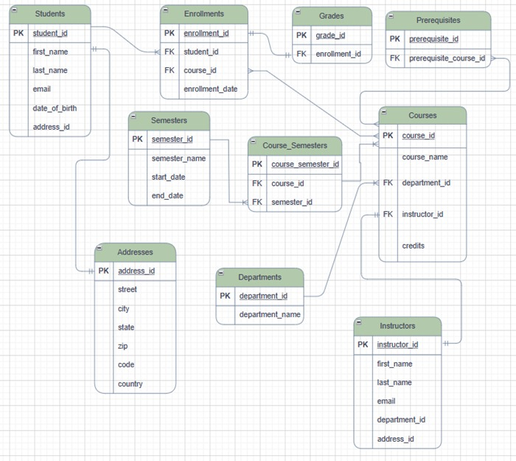
ER Diagram

Slide 6
Database Design: Relationships and Normalization
• Relationships:
Students 1:N Enrollments.
Courses N:N Semesters (via Course_Semesters).
• Normalization:
Up to 3NF (e.g., Addresses separated to avoid redundancy).

Slide 7
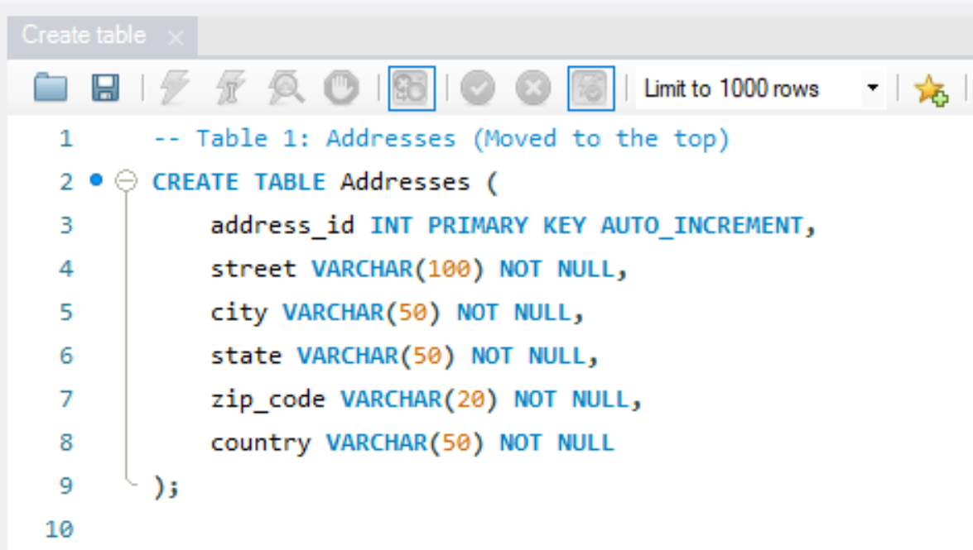
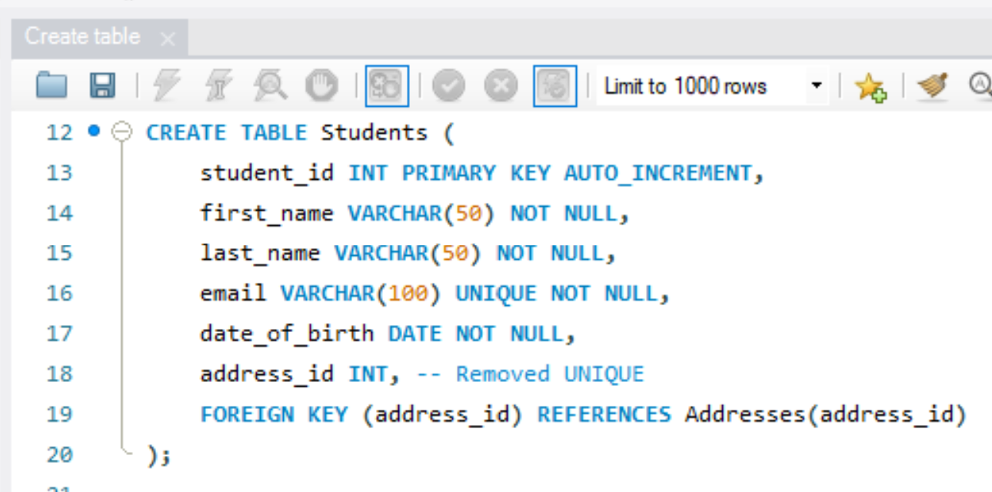
DDL: Database Creation
Used CREATE TABLE to define tables.
Constraints:
PRIMARY KEY, FOREIGN KEY, NOT NULL, UNIQUE.

Slide 8
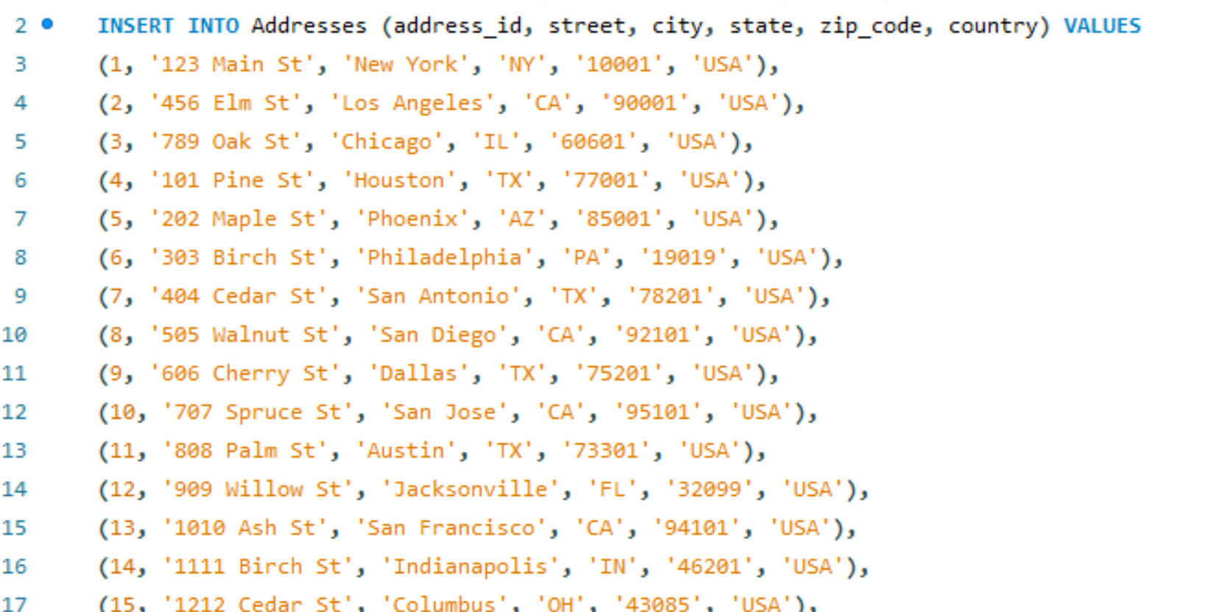
DML: Data Population
Data inserted:
70 students, 20 instructors, 50 courses, 10 departments, 10 semesters.
70 enrollments, 70 grades, 28 prerequisites.
Example:

Slide 9
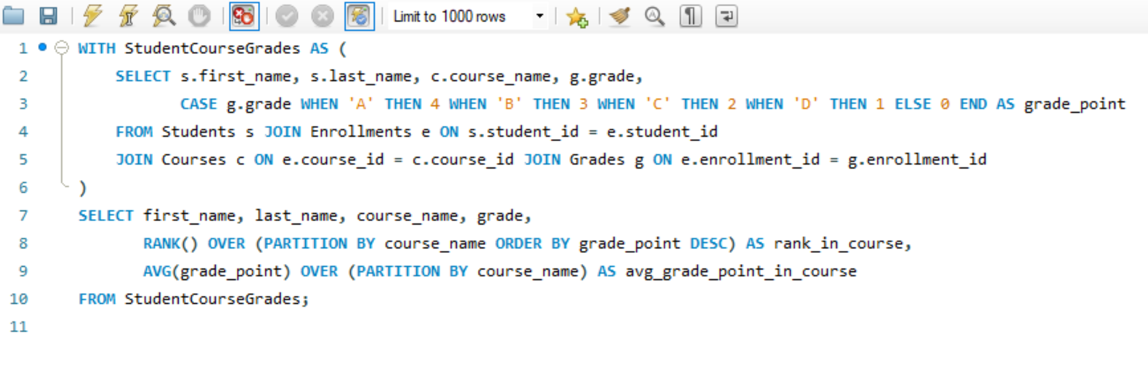
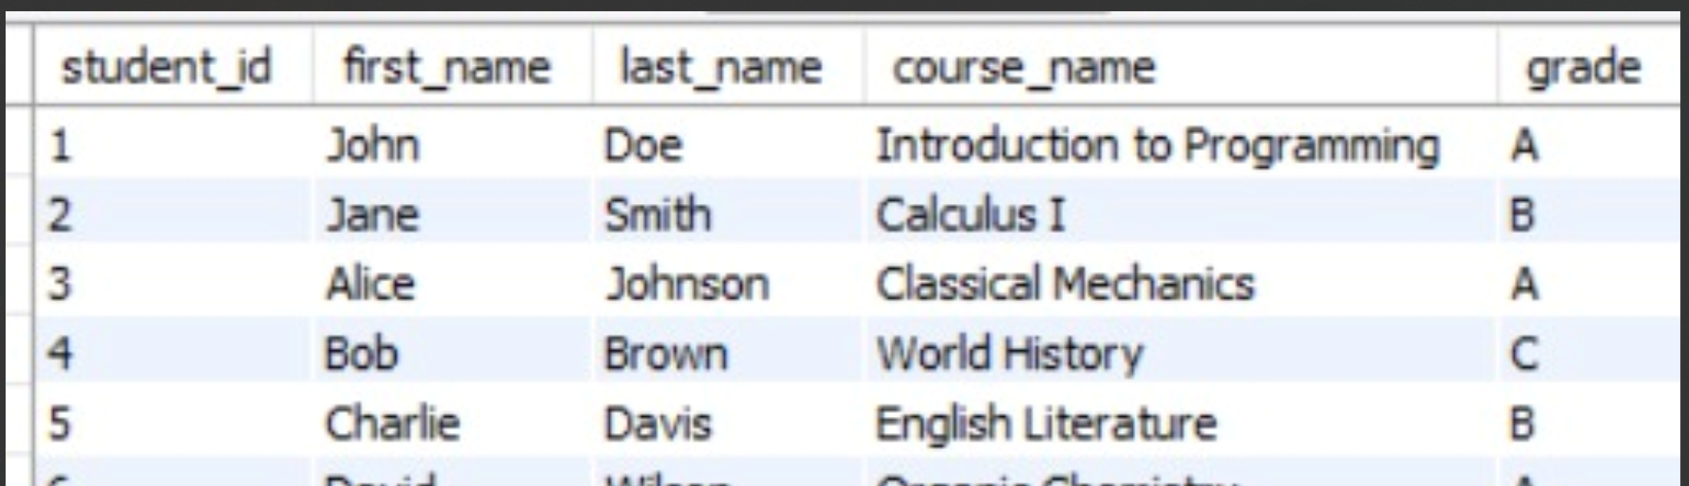
DQL: Reports and Analysis (Part 1 - University System)
Report 1: Student Performance by Course (with Ranking)
Output:

Slide 10
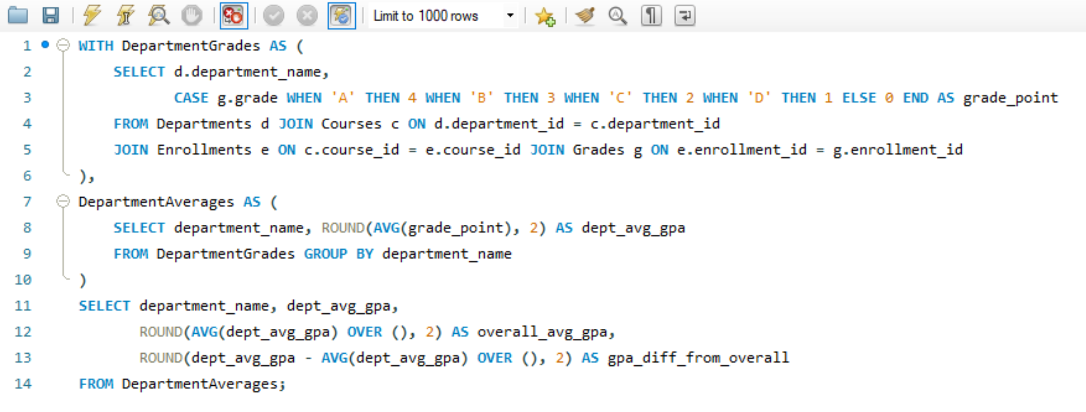
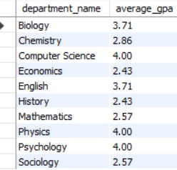
DQL: Reports and Analysis (Part 1 - University System)
Report 2: Average Grade per Department
Output:

Slide 11
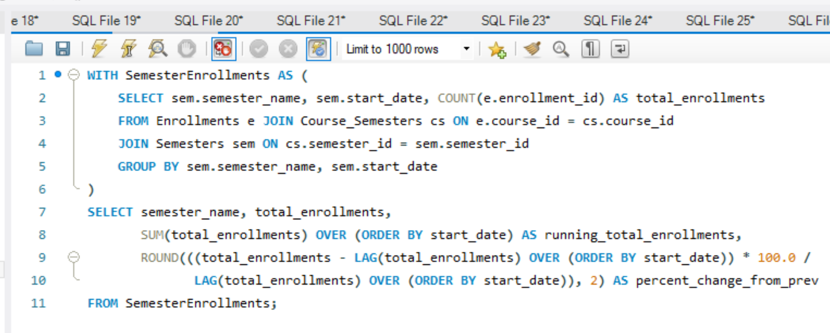
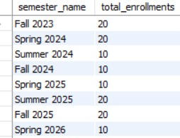
DQL: Reports and Analysis (Part 2 - University System)
Report 3: Enrollment Trends per Semester
Output:

Slide 12
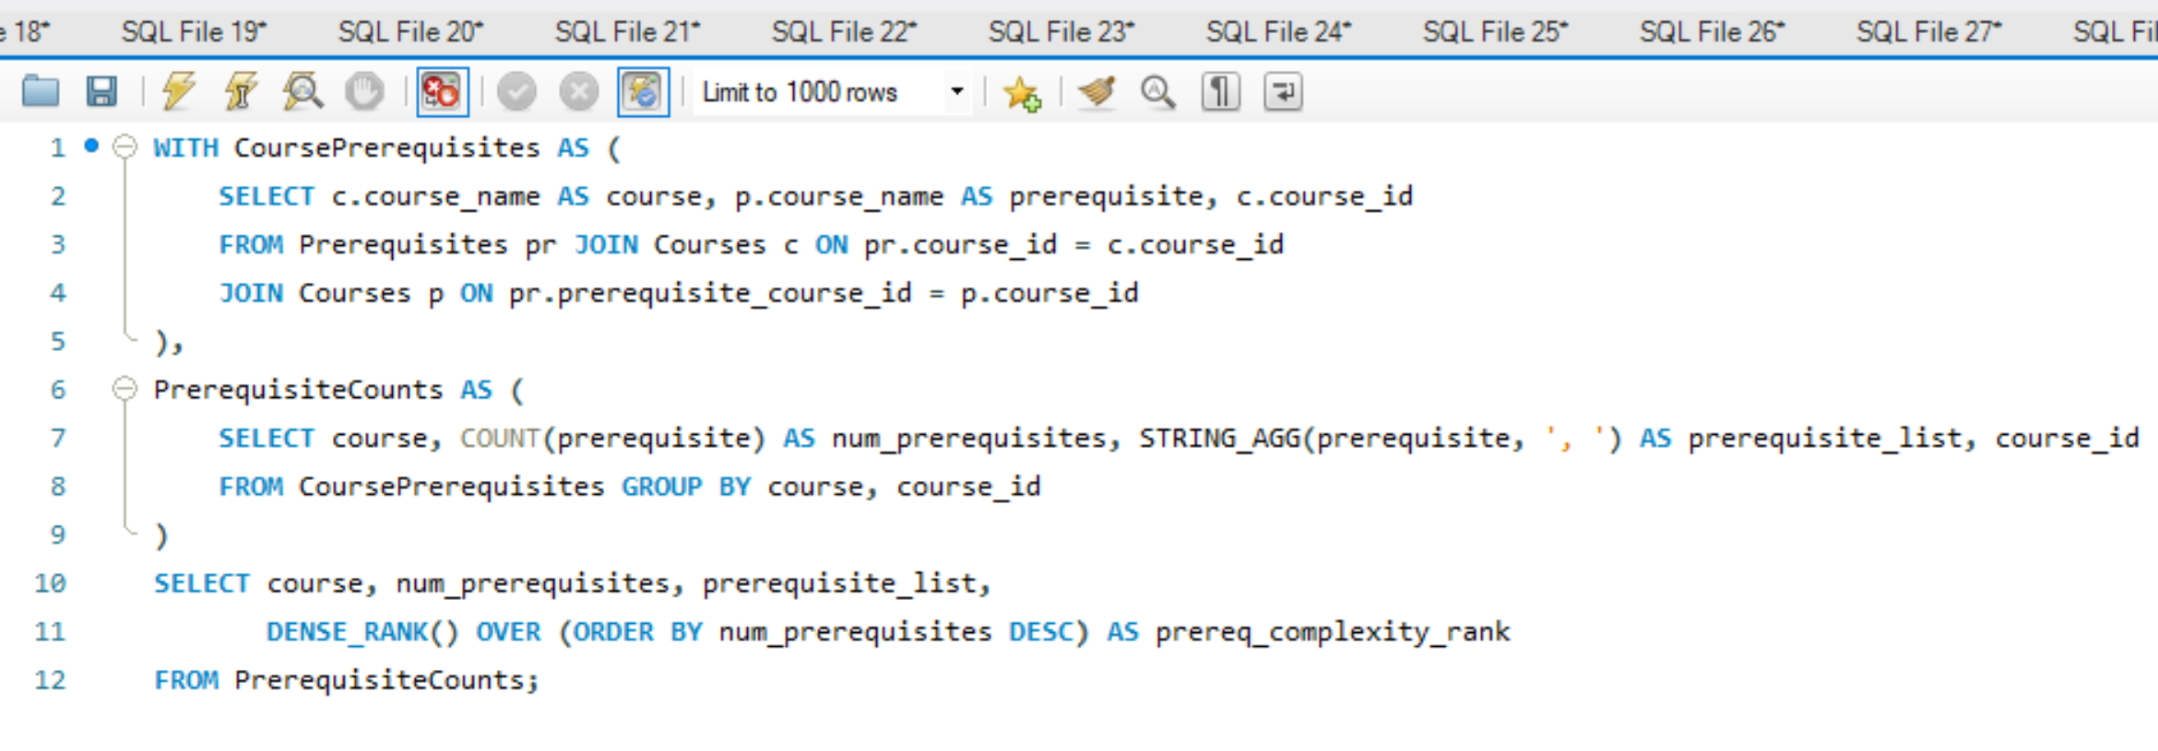
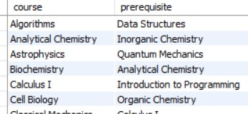
DQL: Reports and Analysis (Part 2 - University System)
Report 4: Courses and Their Prerequisites
Output:

Slide 13
Machine Learning Integration
University System Datasets:
Features for Predicting Grades: student_id, feature_student_avg_gpa, course_name, feature_course_credits, feature_department.
Features for At-Risk Students: student_id, feature_failed_courses, feature_avg_grade_semester, feature_num_enrollments.
Features for Course Scheduling: course_id, feature_enrollment_count, feature_avg_grade, feature_popularity_rank.
Features for Instructor Evaluation: instructor_id, feature_num_students_taught, feature_avg_grade_given, feature_avg_course_difficulty.
Example:
Predict student grades, identify at-risk students, optimize course scheduling, or evaluate instructor performance.

Slide 14
Conclusion and Next Steps
Conclusion:
Functional university database with 10 tables.
Supports academic operations, machine learning, and additional business analyses.
Next Steps:
Add more tables (e.g., events, libraries).
Implement triggers for automatic updates (e.g., GPA).
Develop a dashboard for data visualization.

